Slide 1

TETRA Ireland
National Digital Radio Service

Slide 2




NDRS:
The National Digital Radio Service (NDRS) is a purpose-built secure digital mobile radio network owned and managed by TETRA Ireland
Developed to meet the needs of our Security, Fire, Health & Safety, Government & Public Service agencies.
The network provides unique benefits including instant one-to-one and one-to-many radio communication.
Coverage
Resilient
InterOP
SECURE
2
Notes:
JACAMAR MTH800 & MTM800 EU
Participant Guide - Version 1.3
2
Purpose built – NOT a GSM network. Limited to govt agencies & utilities therefore no contention issues. Point out the 4 mains tenants of the network – Coverage, Resilience, InterOp & Security

Slide 3
Key Advantages
Managed network
Clearer voice communications
Instant comms - Fast call set-up time - 300ms
Interop
Secure
Available when required

Slide 4
Network Features:
Group Call
Individual Call
DMO
Highly efficient one-to-many conversation, fast and easy to set-up 0.3seconds
One-to-one full / half duplex conversation
Direct Mode Operation
Emergency Call
SDS
Easily accessible emergency button - emergency calls have highest priority .
Short data services
Predefined groups
Notes:
4
Highlight the various features:
Group Call - Users that have the same talkgroup selected in the radios are able to communicate with each other on a half duplex basis. Half duplex commununication means that one user is speaking (transmitting) while the others in the same group listen to the person that is transmitting. The listeners can only start to talk (transmit) when the other it finished.
The TETRA individual call is a one-to-one call. The calling party selects the call sign in the radio contact list or by typing in the number using the keypad.
The ultimate fallback mode is Direct Mode Operation (DMO), where TETRA terminals can talk to each directly, irrespective of network availability.

Slide 5
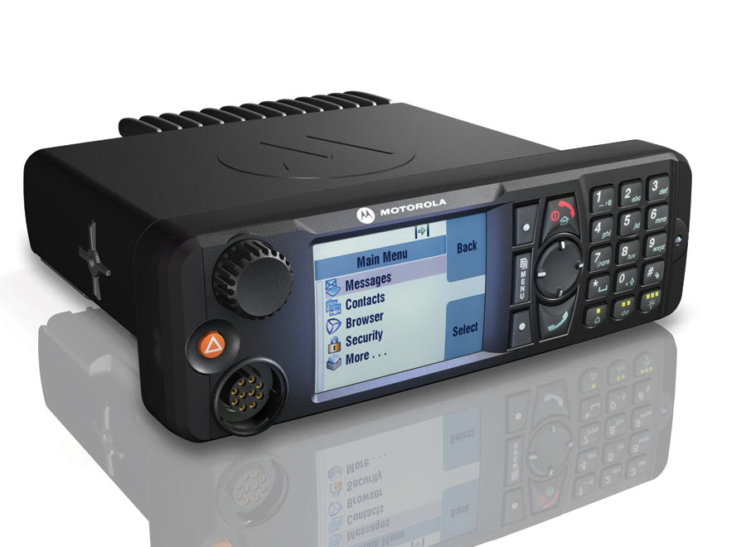
MTM 5400 Terminal
Notes:
JACAMAR MTH800 & MTM800 EU
Participant Guide - Version 1.3
5
__________________________________________________________________________________________________________________________________________________________________________________________________________________________________________________________________________________________________________________________________________________________________________________________________________________________________________________________________________________________________________________________________________________________________________________________________________________

Slide 6
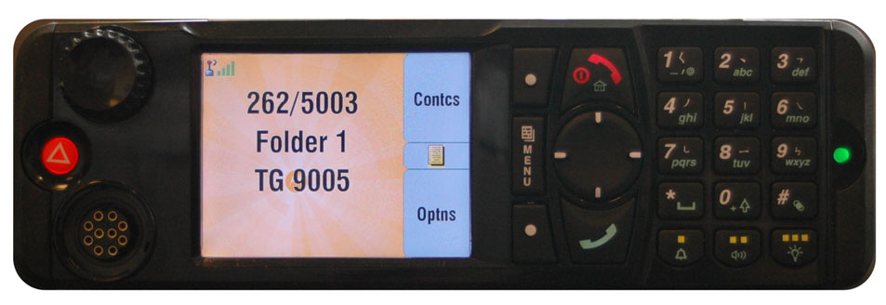
Controls & Indicators
On-Off/
End/Home
Rotary Knob
Colour Display
Menu Button
Keypad
LED
Soft Keys
Emergency Button
Mic/Headset
Connector
function
Keys
Navigation
Key
6
Notes:
JACAMAR MTH800 & MTM800 EU
Participant Guide - Version 1.3
6
Describe location of all keys. Pointing out the similarity to hand portable radio
Do not demonstrate function or go into great detail at this time.
Main difference is the 3 soft keys

Slide 7
Power On/Off
Powering On
  Press and hold the On-Off/End/Home key
Powering Off
  Press and hold the On-Off/End/Home key
  You will see the Powering Off message
Page Ref – FUG - 7
7
Notes:
JACAMAR MTH800 & MTM800 EU
Participant Guide - Version 1.3
7
Explain procedure and demo it.
Point out if a vehicle is fitted with ignition sense the radio will power on or off when the vehicle is turned on or off.

Slide 8
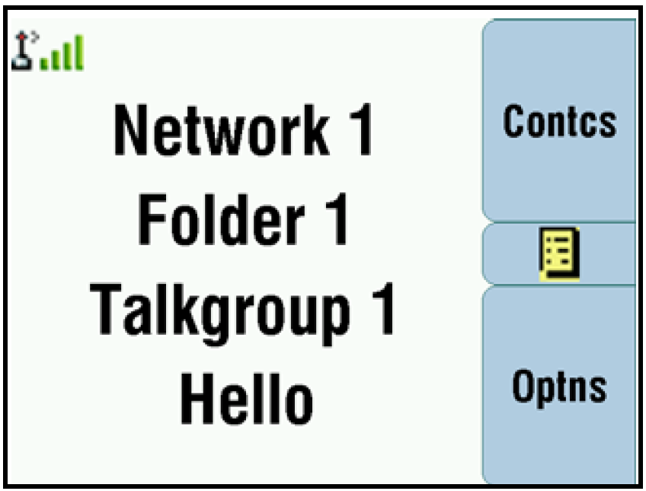
Display
Function key
Status Icon
Area
Menu
Text Area
Function key
8
Notes:
JACAMAR MTH800 & MTM800 EU
Participant Guide - Version 1.3
8
Power-up radio. Point out location of different display areas.

Slide 9
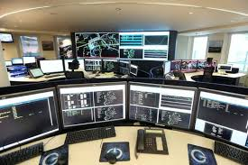
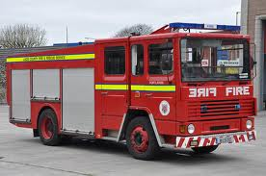
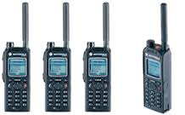
Group Call
Instant communication between you and others in a selected group
Participants may join or leave an on-going group call
A group is a predefined set of radios enabled to participate in and make a Group Call
Page Ref – FUG - 33
9
Notes:
JACAMAR MTH800 & MTM800 EU
Participant Guide - Version 1.3
9
Discuss group
Point out that most system communication is usually Group Calls
call

Slide 10
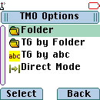
Talkgroup Selection
Select ‘Options’ on Home Screen
You can select a Talkgroup in one of the following ways:
  Navigation key
    Left or Right and press Select
  Alphabetical search feature
  Folder search
  Rotary Knob
Page Ref – FUG - 34
10
Notes:
JACAMAR MTH800 & MTM800 EU
Participant Guide - Version 1.3
10
Demonstrate changing Talkgroups, allow delegates to carry out the procedure

Slide 11
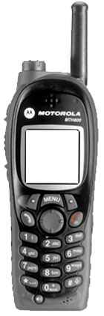
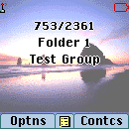
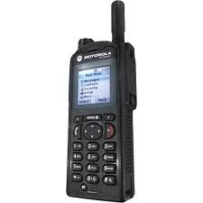
Private Call
Point-to-Point communication between two individuals
Not transmitted to other Talkgroup members
Half Duplex ( press to talk release to listen )
Page Ref – FUG - 55
11
Notes:
JACAMAR MTH800 & MTM800 EU
Participant Guide - Version 1.3
11
Discuss Private call
Half duplex

Slide 12
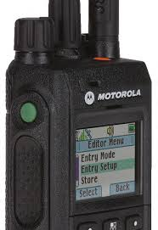
Individual Call Operations ‏
Making a Call
  Enter required ISSI on keypad
  (or access call sign from phonebook)
  Press PTT to make call
Answering the Call
  When radio rings - Press PTT to answer
  You can then have a one-to-one conversation. Remember:
  Push to Talk, Release to listen.
Page Ref – FUG - 38
12
Notes:
JACAMAR MTH800 & MTM800 EU
Participant Guide - Version 1.3
12
Demonstrate procedure, allow delegates to carry out the procedure
Have all users answer a radio check
Call will drop after 7 seconds if not in use

Slide 13

DMO Direct Mode Operation
Back to Back comms
Off network
Notes:
DMO – back to back off net comms. Line of sight, localised incident.

Slide 14
To Select DMO
Scroll to Direct Mode
Press select
Terminal will enter DMO

Slide 15
Emergency Call Operations ‏
End/Exit Key
To initiate Emergency Mode:
  Push and hold the Emergency Key until Emergency Mode starts
    0.5 seconds
Emgy In Use
Water Services
Exit
Optns Exit
To exit Emergency Mode:
  This is a 2 step process.
  Push END Button
  Then Push and Hold the Exit Key until Emergency Mode stops
    2.0 seconds
Page Ref – FUG - 67
15
Notes:
JACAMAR MTH800 & MTM800 EU
Participant Guide - Version 1.3
15
Demonstrate the procedures
Allow delegates to practice the procedures.

Slide 16
Emergency Call Procedure
The Emergency call will go to dedicated terminal in RCC
Terminal will go into ‘Hot-Mic’ mode for 15 seconds
To end alarm – First ‘End’ then ‘Exit’ – screen will prompt

Slide 17
Emergency Power On
If pressed when radio is off, the radio will automatically power on in Emergency Mode.
Page Ref – FUG - 6
17
Notes:
JACAMAR MTH800 & MTM800 EU
Participant Guide - Version 1.3
17
Discuss but do not demonstrate the procedure

Slide 18
Short Cuts & Quick Buttons Status Messaging

Slide 19
Dash Mount – Press & Hold Options
 | National Status | Description
Yellow 1 | RTS | Request To Speak
Yellow 3 | PRTS | Priority Request to Speak
1 | MTI | Mobile to Incident
2 | IA | In Attendance
3 | AAI | Available at Incident
4 | MAV | Mobile and Available
5 | AHS | At Home Station
6 | DOM | Defensive Operational Mode
7 | OOM | Offensive Operational Mode
8 | TOM | Transitional Operational Mode
9 | MNA | Mobile Not Available
0 | MLA | Mobile with Limited Availability
* | MOS | Mobile on Standby
# | AS | At Standby
Menu 1 | LS | Leaving Medical Scene
Menu 1 | AH | At Hospital

Slide 20
Shortcuts
Menu & 2 = GPS
Menu & 3 = Last Status sent
Menu & 4 = ISSI number (my info)

Slide 21
Practical exercise
Send RTS
Send PRTS
Send MTI
Find Last sent Status
Send Emergency/ Cancel Emergency
Move Talkgroup
Private call from contacts
Find own info – ISSI number
Find GPS
Home Screen
Volume

Slide 22
Customer Service Centre / Fault Reporting
Customer Tailored Service Level Agreements
Sigma Wireless supports TETRA Ireland and their customers by providing the following:
•The TETRA Ireland Customer Service Centre (CSC)
•Network and terminal support
•24/7/365 Operational Support
Any faults to be reported to MRCC

Slide 23


